Slide 1
Machine Learning (Review of ML Concepts)

Slide 2
Contents
Data
Model
Evaluation Metrices
Predictive Analysis
Bias Vs. Variance
Parametric Vs. Non-parametric
Hyperparameters
Few more..

Slide 3
Data
The foundation of machine learning, data comprises training examples used to teach models. It includes features (input variables) and labels (the target or output variable).
Few famous datasets:
Kaggle Datasets (https://www.kaggle.com/datasets)
UCI Machine Learning Repository
( https://archive.ics.uci.edu/ml/index.php)
Bioinformatics Datasets (NCBI, CCLE, GDSC, etc.)
Amazon Datasets
Microsoft Datasets
Google Datasets (https://datasetsearch.research.google.com/)
Notes:
I

Slide 4
Model
Model: A mathematical representation of a system that learns patterns from data. It can be a decision tree, neural network, support vector machine, etc.
Training: It refers to the process of teaching a model to make predictions or decisions by learning patterns and relationships from data.
Testing/Evaluation: Assessing a model's performance on unseen data to gauge its predictive accuracy.

Slide 5
Evaluation Metrics
Classification (Predict Category):
Simple Accuracy
Precision
Recall
F Measure
F beta Measure
ROC (and AUC)
Regression (Predict Value)
Sum of Squares Error
Mean Absolute Error
RMSE

Slide 6
Confusion Matrix
In the field of machine learning, a confusion matrix is a specific table layout that allows visualization of the performance of an algorithm
 | Predicted Negative | Predicted Positive
Actual Negative | True Negative | False Positive
Actual Positive | False Negative | True Positive

Slide 7
Confusion Matrix
TN is the number of correct predictions that an instance is negative
FP is the number of incorrect predictions that an instance is positive
FN is the number of incorrect predictions that an instance is negative
TP is the number of correct predictions that an instance is positive

Slide 8
COVID-19 Example
True Positive: You have COVID-19 and you are tested positive.
True Negative: You don’t have COVID-19 and you are tested negative.
False Positive: You don’t have COVID-19 but you are tested positive.
False Negative: You have COVID-19 but you are tested negative.

Slide 9
Confusion Matrix
Confusion Matrix from the example of KNN (without Normalization)
ID | Actual | Predicted
1 | 1 | 1
2 | 0 | 0
3 | 1 | 1
4 | 1 | 0
Positive | Negative
0 | 1 | Negative
2 | 1 | Positive

Slide 10
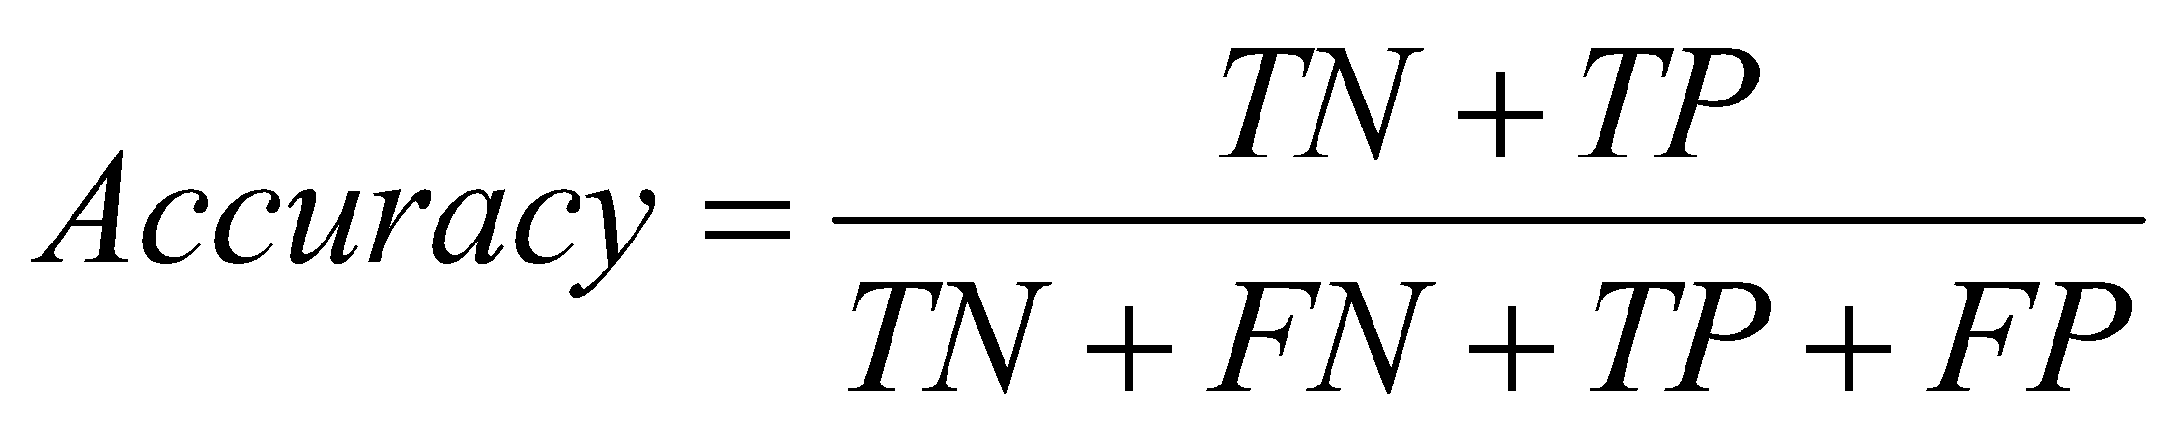
Confusion Matrix
Several standard terms have been defined for the 2 class matrix
The accuracy (AC) is the proportion of the total number of predictions that were correct
Accuracy = 3 / 4 = 75%

Slide 11
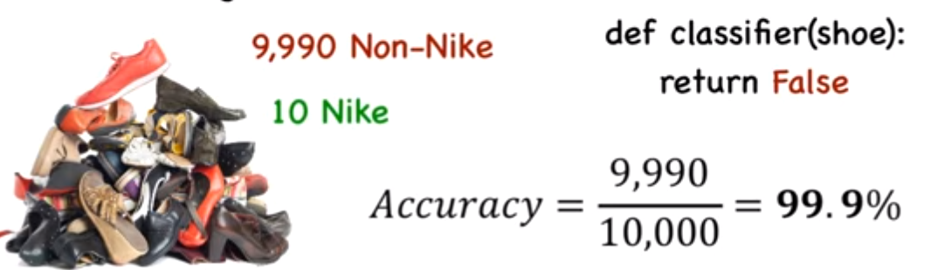
What’s wrong with this?
it may be a poor measure for imbalanced data

Slide 12
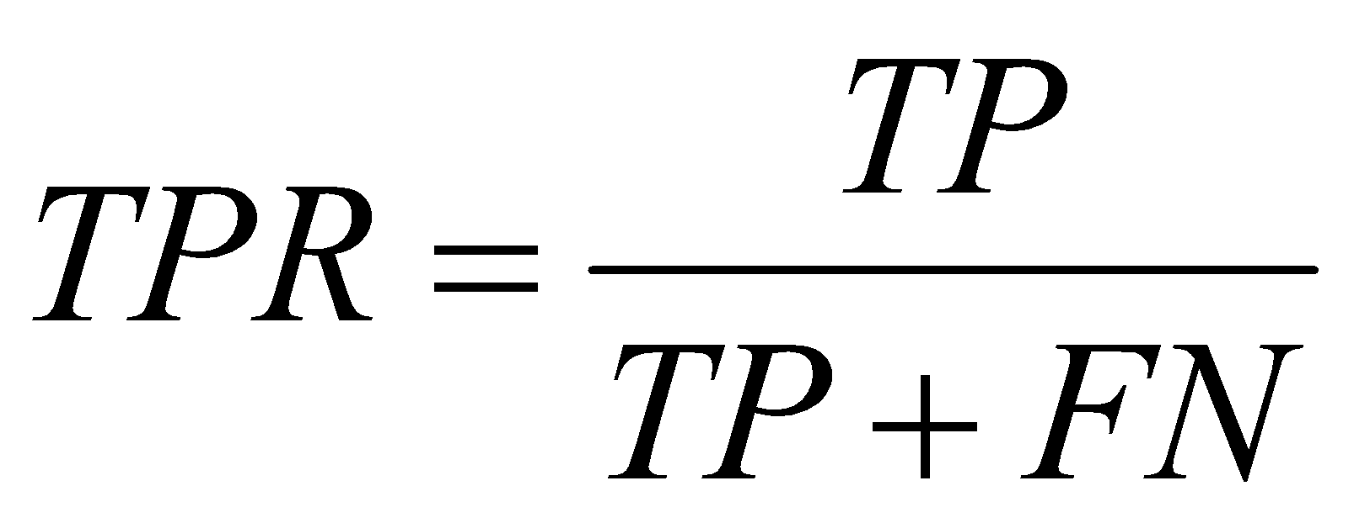
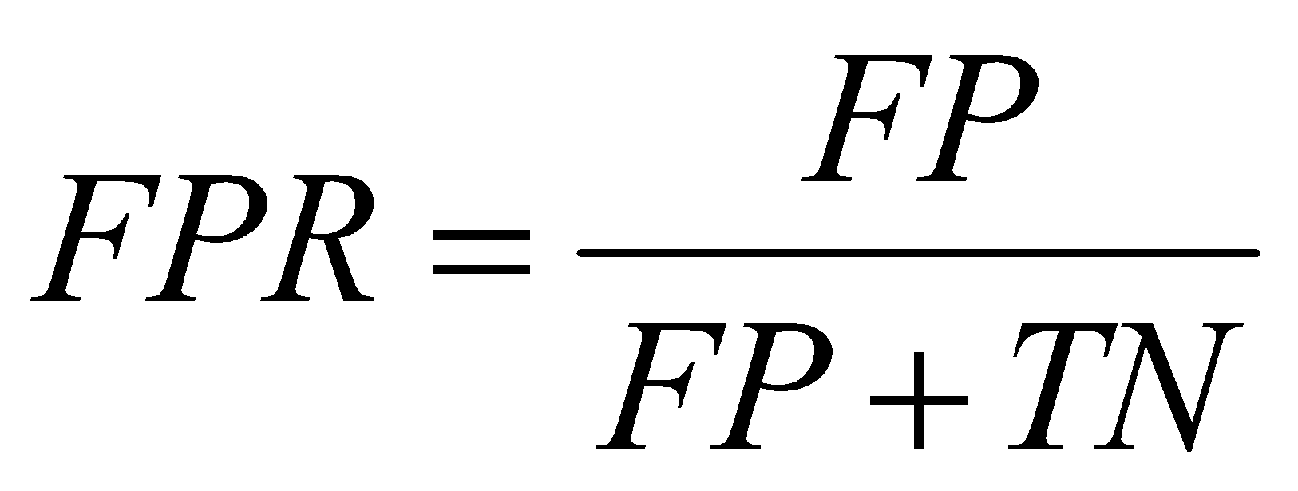
Confusion Matrix
The recall (Sensitivity) or true positive rate (TPR) is the proportion of positive cases that were correctly identified
True Pos. /# actual pos.
The false positive rate (FPR) is the proportion of negatives cases that were incorrectly classified as positive
TPR or recall = 2 / 3 = 66.7%
FPR = 0 / 1 = 0 %

Slide 13
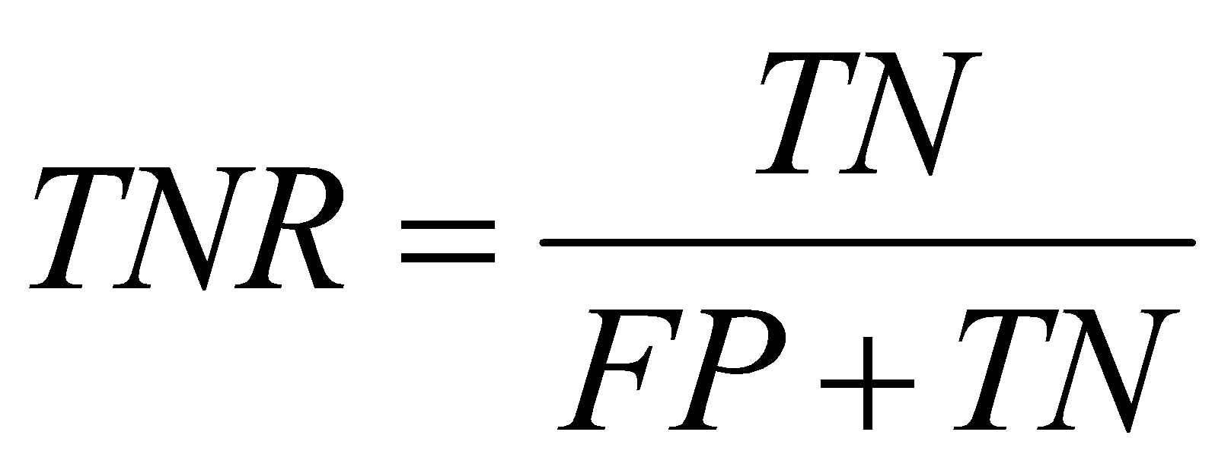
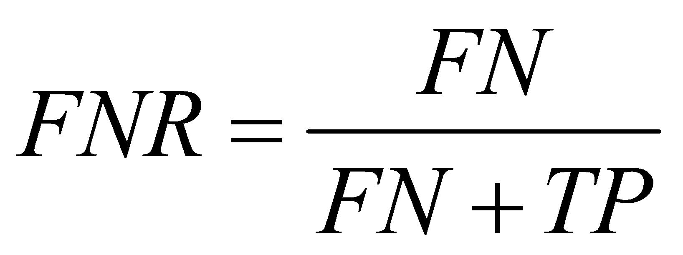
Confusion Matrix
The true negative rate (TNR) is defined as the proportion of negatives cases that were classified correctly,
The false negative rate (FNR) is the proportion of positives cases that were incorrectly classified as negative
TNR = 1 / 1 = 100%
FNR = 1 / 3 = 33.3%

Slide 14
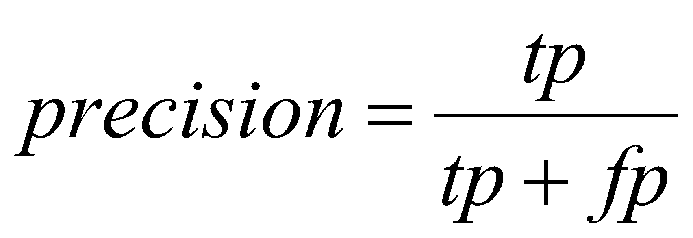

Confusion Matrix
precision (P) is the proportion of the predicted positive cases that were correct
True pos. / # predicted pos.
precision = 2/2 = 100%
F measure is harmonic mean of precision and recall
F1 = (2 * 1 * 0.667)/(1+0.667) = 0.8

Slide 15
Accuracy Vs. Precision Vs. Recall
Use accuracy only if you have balanced datasets and you give the same importance to 0s and 1s.
Recall is more important where Overlooked Cases (False Negatives) are more costly than False Alarms (False Positive). The focus in these problems is finding the positive cases.
Precision is more important where False Alarms (False Positives) are more costly than Overlooked Cases (False Negatives).

Slide 16
Example
We are trying to build a classifier to identify whether a particular insurance claim is fraudulent. Recall and precision, which is a better metric for our problem? Why?
Recall
In marketing campaigns system, which metric is better?
Precision

Slide 17
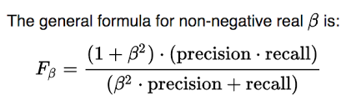
Fbeta Measures
Formula:
Beta = 1 is the default value. The formula becomes – F1 score = (2 * Precision * Recall) / (Precision + Recall)
To prioritize precision, you can set a smaller beta value such as 0.5. The formula becomes – F0.5 score = (1.25 * Precision * Recall) / (0.25 * Precision + Recall)
To prioritize recall, you can set a larger beta value such as 2. The formula becomes – F2 score = (5 * Precision * Recall) / (4 * Precision + Recall)

Slide 18
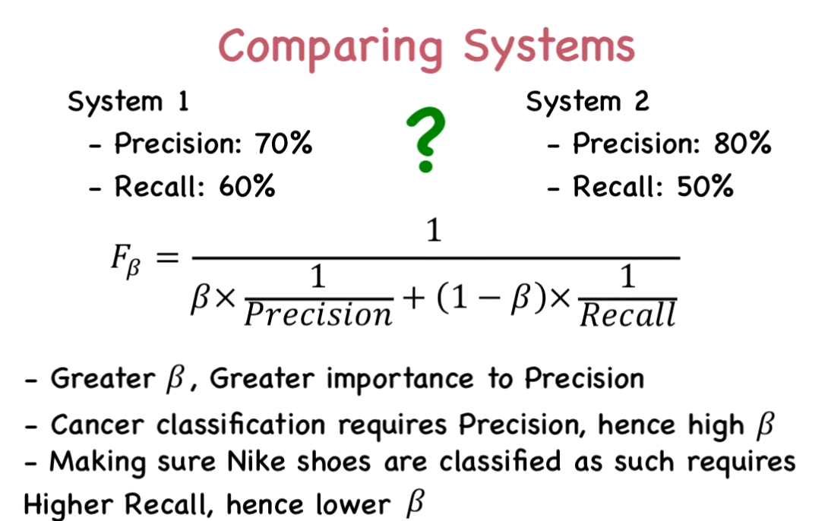
Fbeta Measures

Slide 19
Receiver Operating Characteristic (ROC) Curve
Purpose: Analyzing the strength/predictive power of a classifier
The ROC curve is a plot of True Positive Rate (TPR) on the y-axis Vs False Positive Rate (FPR) on the x-axis.
TPR = Sensitivity FPR = 1-Specificity
It is better to understand ROC Curve in their original form, TPR Vs FPR.

Slide 20
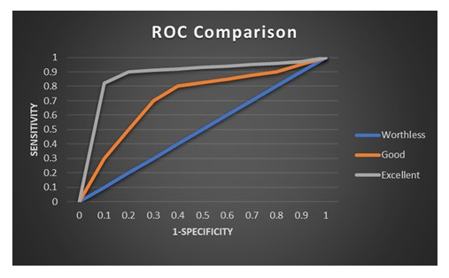

Slide 21
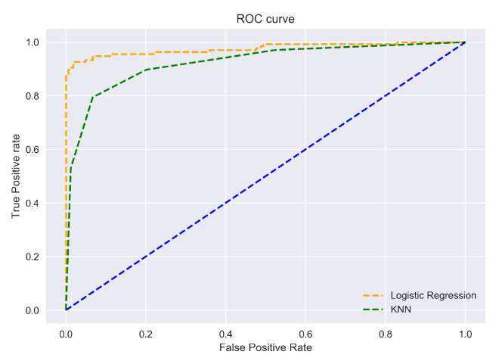
AUC-ROC Curve between LR vs. KNN

Slide 22
Cross Validation
Validation techniques in machine learning are used to get the error rate of the ML model which can be considered as close to the true error rate of the population.
In case the data volume is large enough to be representative of the population, you may not need the validation techniques.
However, in real world scenario, we work with the sample of data which may not be the true representative of the population.
This is where validation techniques come into the picture.

Slide 23
Predictive Accuracy Evaluation (Types of Cross Validation Methods)
The main methods of predictive accuracy evaluations are:
Resubstitution (N ; N);
Holdout (2N/3 ; N/3)
k-fold cross-validation (N-N/k ; N/k)
Leave-one-out (N-1 ; 1)
where N is the number of instances in the dataset

Slide 24
Predictive Accuracy Evaluation
N = 100
Resubstitution (100 ; 100);
Holdout (70 ; 30)
k-fold cross-validation (90 ; 10);
Leave-one-out (99 ; 1);
where N is the number of instances in the dataset

Slide 25
Training and Testing
REMEMBER: we must know the classification (class attribute values) of all instances (records) used in the test procedure.
Basic Concepts Success: instance (record) class is predicted correctly
Error: instance class is predicted incorrectly
Error rate: a percentage of errors made over the whole set of instances (records) used for testing
Predictive Accuracy: a percentage of well classified data in the testing data set.

Slide 26
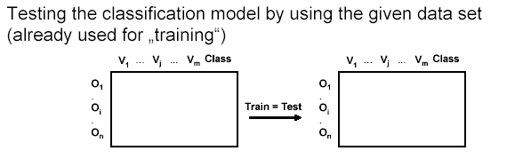
Resubstitution (N ; N)

Slide 27
Resubstitution Error Rate
Error rate is obtained from training data
NOT always 0% error rate, but usually (and hopefully) very low!
Resubstitution error rate indicates only how good (bad ) are our results (rules, patterns, NN) on the TRAINING data; expresses some knowledge about the algorithm used

Slide 28
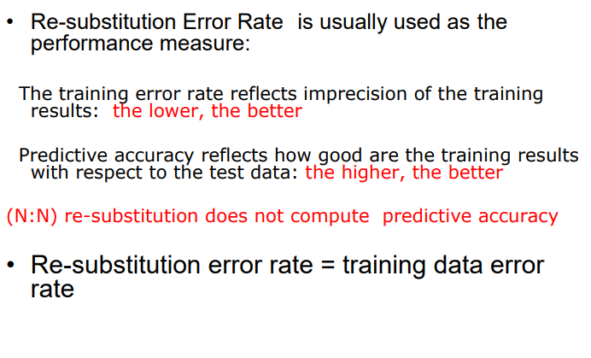
Resubstitution Error Rate

Slide 29
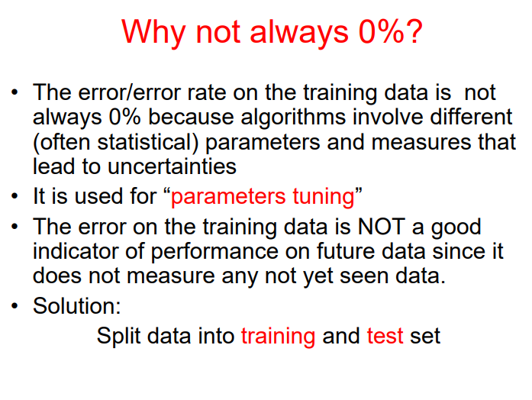

Slide 30
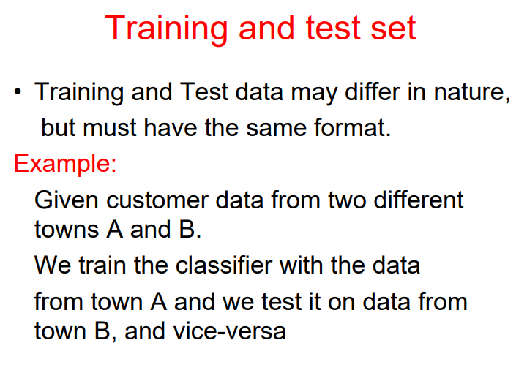

Slide 31
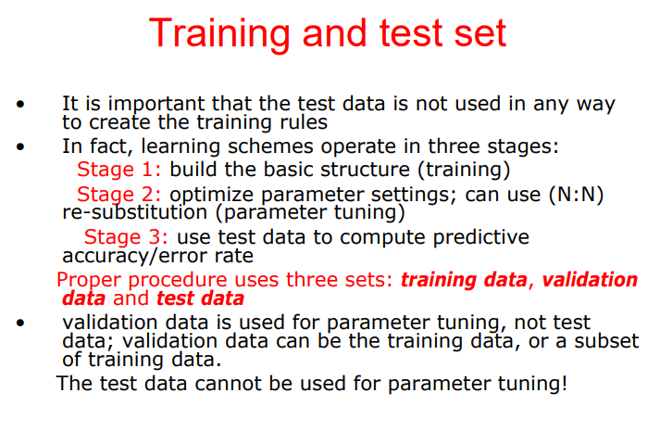

Slide 32
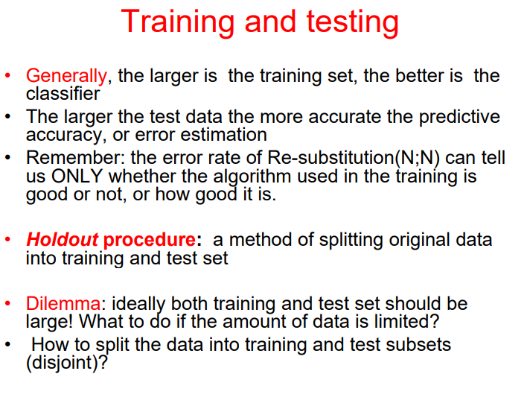

Slide 33
Holdout (2N/3 ; N/3)
The holdout method reserves a certain amount for testing and uses the remainder for training – so they are disjoint!
Usually, one third for testing, and the rest for training
Train-and-test; repeat

Slide 34
Holdout (2N/3 ; N/3)
Generally, the larger is the training the better is the classifier
The larger the test data the more accurate the error estimate
Holdout procedure: a method of splitting original data into training and test set
Dilemma: ideally both training and test set should be large! What to do if the amount of data is limited?
How to split?

Slide 35
Holdout Method
Problem: the samples might not be representative
Example: a class might be missing in the test data
Advanced version uses stratification
Ensures that each class is represented with approximately equal proportions in both subsets
It doesn’t prevent bias in the training and test sets

Slide 36
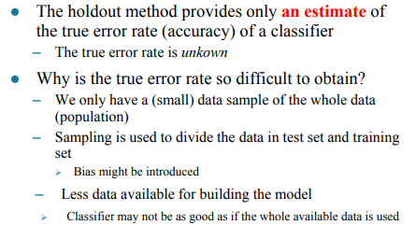
Estimate Error Rate with Holdout Method

Slide 37
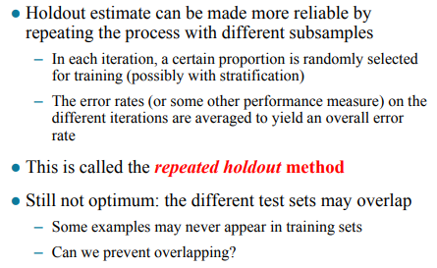
Repeated Holdout Method

Slide 38
k-fold cross-validation (N-N/k ; N/k)
cross-validation is used to prevent the overlap!
cross-validation avoids overlapping test sets:
first step: split data into k subsets of equal size
second step: use each subset in turn for testing, the remainder for training
The error estimates are averaged to yield an overall error estimate

Slide 39
Cross-validation
Standard cross-validation: 10-fold cross-validation
Why 10?
Extensive experiments have shown that this is the best choice to get an accurate estimate. There is also some theoretical evidence for this. So interesting!

Slide 40
Improve cross-validation
Even better: repeated cross-validation
Example:
10-fold cross-validation is repeated 10 times and results are averaged (reduce the variance)

Slide 41
A particular form of cross-validation
k-fold cross-validation: (N-N/k ; N/k)
If k= N, what happens?
We get:
(N-1; 1)
It is called “leave –one –out”

Slide 42
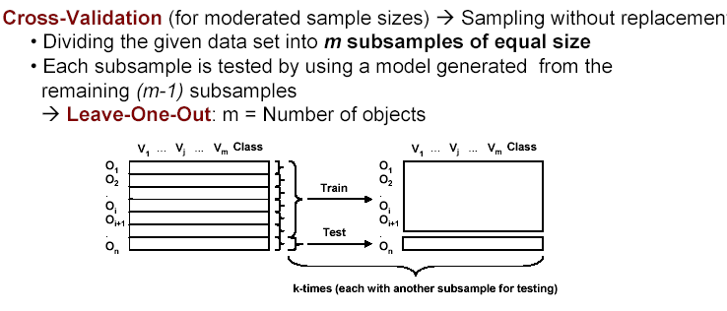
Leave-one-out (N-1 ; 1)

Slide 43
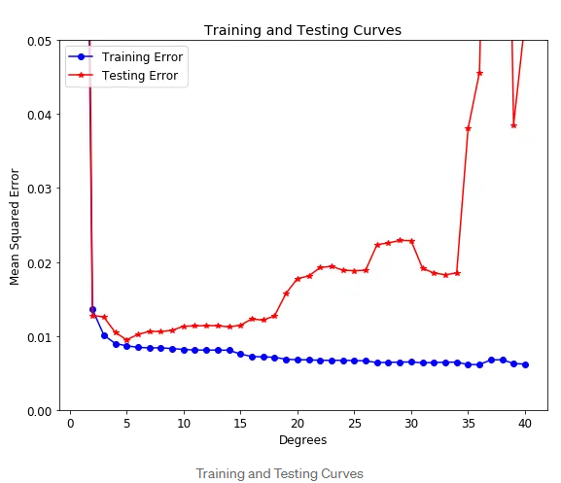
Overfitting Vs. Underfitting
A model that is underfit will have high training and high testing error while an overfit model will have extremely low training error but a high testing error.

Slide 44
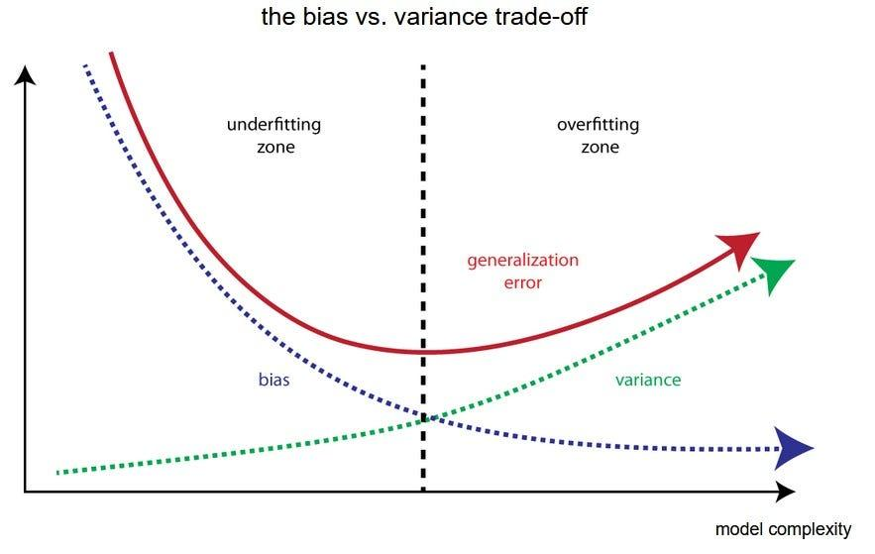
Bias Vs Variance

Slide 45
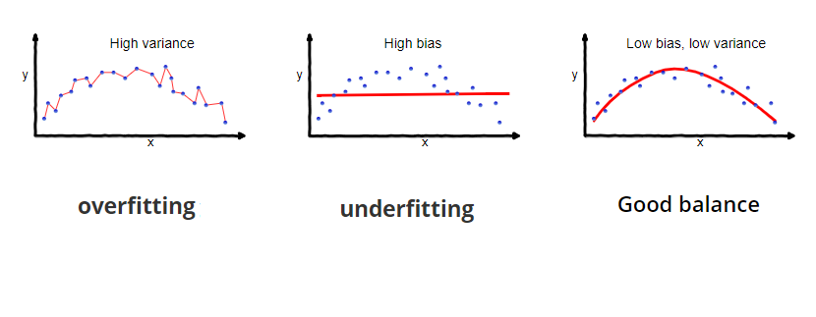
Continued

Slide 46
Parametric Vs. Non-Parametric Algorithms
Parametric and non-parametric algorithms are two different approaches in statistical and machine learning modeling.
They differ in how they make assumptions about the underlying data distribution and how they learn from data.

Slide 47
Parametric Algorithms
Assumption of Data Distribution: Parametric algorithms make strong assumptions about the data distribution. They assume that the data follows a specific probability distribution, such as Gaussian (normal) distribution.
Fixed Number of Parameters: In parametric models, the number of parameters used to describe the data is fixed and does not grow with the size of the dataset. For example, linear regression assumes a linear relationship between input features and the target variable.
Model Complexity: Parametric models are often simpler and have a limited capacity to capture complex patterns in data. They are suitable for situations where the underlying assumptions are met.
Efficiency: Parametric models are computationally efficient and require less data for training because of their simplicity.
Examples: Linear regression, logistic regression, Gaussian Naive Bayes, and linear discriminant analysis are examples of parametric models.

Slide 48
Nonparametric Algorithms
No Assumption of Data Distribution: Non-parametric algorithms do not assume a specific data distribution. They are more flexible and make fewer assumptions about the data.
Variable Number of Parameters: Non-parametric models have a variable number of parameters, which can adapt and grow as more data is provided. This adaptability allows them to capture complex patterns.
Model Complexity: Non-parametric models tend to be more complex and can capture intricate relationships in data, making them suitable for a wide range of situations, including those where the underlying distribution is unknown.
Data Efficiency: Non-parametric models may require more data for training because they are flexible and can capture complex relationships. They are less data-efficient than parametric models.
Examples: Decision trees, k-nearest neighbors (KNN), support vector machines (SVM), and kernel density estimation are examples of non-parametric models.

Slide 49
Hyperparameters
Anything in machine learning and deep learning that you decide their values or choose their configuration before training begins and whose values or configuration will remain the same when training ends is a hyperparameter.
Here are some common examples
Train-test split ratio, Learning rate, Choice of activation function in nn layer, cost or loss function, Number of hidden layers & activation units in each layer, drop-out rate in nn (dropout probability), Number of iterations (epochs), etc.

Slide 50
Few more concepts
Feature Selection: The process of choosing a subset of relevant features to reduce dimensionality and improve model performance.
Ensemble Learning: Combining the predictions of multiple models to improve accuracy and reduce overfitting. Common techniques include bagging and boosting.
Deep Learning: A subset of machine learning involving neural networks with multiple layers, used for complex tasks like image and speech recognition.
Gradient Descent: An optimization algorithm used to update model parameters to minimize the error between predicted and actual values.
Regularization: Techniques like L1 (Lasso) and L2 (Ridge) regularization to prevent overfitting by adding penalty terms to the model's loss function.

Slide 51
Questions!

